Slide 1
Introduction to Big Data

Slide 2
Big Data, Big Problems
Financial Industry Regulatory Authority (FINRA): Needs to store 37 billion records daily in the financial market and analyze trends over a period of days, weeks, and months
McDonald’s: Collects transactional data as it serves 69 million people each day in 188 countries
Netflix: Collects ratings, searches, watch dates, device information, pause and skip data, repeat views, and more for 100+ million subscribers

Slide 3
Class Objectives
By the end of today’s class, you will:
Articulate the different components in the Hadoop ecosystem and their primary use cases.
Run MapReduce jobs.
Use Spark DataFrames to process large datasets.

Slide 4
What Is Big Data?

Slide 5
Big Data Examples
Email
Stock exchange data
Search engine results
Social media posts like Facebook statuses and tweets
Supply chain management: inventory, barcodes, tracking
Climate and earth science data
Astronomy data
Internet of things (IoT): industrial sensors, power plants, smart homes, etc.

Slide 6
The Four Vs of Big Data
Volume: Size of the data
Terabytes of stock data
Velocity: How quickly data is coming in
Car sensors sending information every second
Variety: Diversity of data
Social media posts, comments, photos, etc.
Veracity: Uncertainty of data
Social media data may not be precise, come from bots, etc.

Slide 7
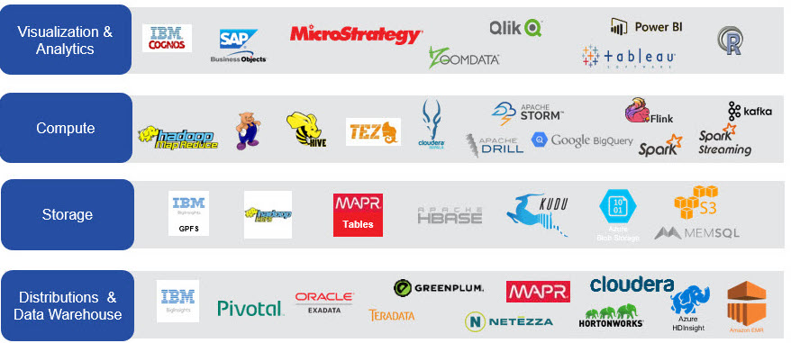
Big Data Tools

Slide 8
Hadoop

Slide 9
What’s Hadoop?
"The Apache Hadoop software library is a framework that allows for the distributed processing of large data sets across clusters of computers using simple programming models. It is designed to scale up from single servers to thousands of machines, each offering local computation and storage. Rather than rely on hardware to deliver high-availability, the library itself is designed to detect and handle failures at the application layer, so delivering a highly-available service on top of a cluster of computers, each of which may be prone to failures.”
–– Hadoop website
Hadoop was named after a stuffed yellow elephant belonging to the son of Doug Cutting, the Hadoop creator.

Slide 10
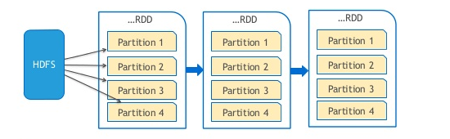
Hadoop Distributed File System (HDFS)
HDFS is a file system that is used to store data across server clusters.
Scalable
Fault-tolerant
Distributed

Slide 11
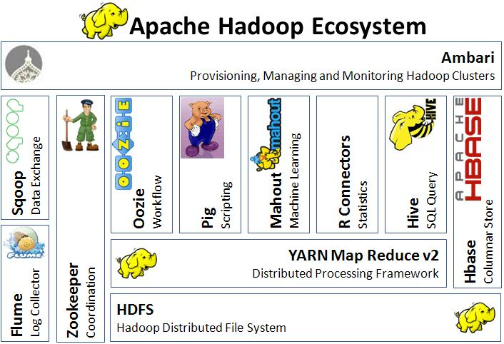
Hadoop Ecosystem

Slide 12
MapReduce

Slide 13

MapReduce Origin Story
Created by Google research labs
Designed to solve a single problem: how to index all the information on the internet

Slide 14
MapReduce Example: Counting Books in a Library
Map: “You count this half of the library, and I’ll count the other.”
Reduce: “We get together and add up our counts.”

Slide 15
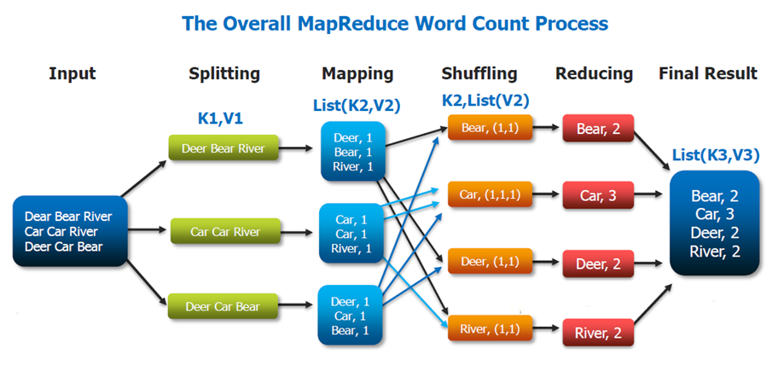
The Map in MapReduce
The mapping step takes a small piece of the input and maps the data to key-value pairs. A common example is sending a line of text to a mapper function, and the mapper generates a key-value pair for each word. The values will be added up later in the reducing step.

Slide 16
The Shuffle in MapReduce
The shuffle step groups the keys together. Each value found for a key is appended to the list of values.

Slide 17
The Reduce in MapReduce
The reducing step reduces the list of values for a key to a single value. In this example, the values are added to get the count of each word.

Slide 18
mrjob

Slide 19

mrjob
A Python library built by Yelp
Writes MapReduce jobs in Python and runs them on different platforms

Slide 20
mrjob Fundamentals

Slide 21
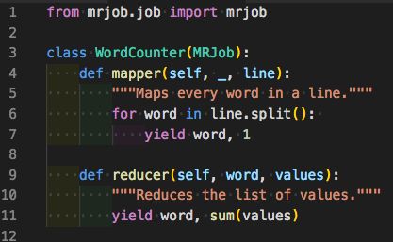
What’s a Job?
A job is a Python class (like a blueprint) that contains the code for the mappers and reducers.
mrjob can translate the job and run it locally or on a Hadoop cluster.
Note: The shuffle step is hidden and handled by mrjob behind the scenes.

Slide 22
Spark (PySpark)

Slide 23
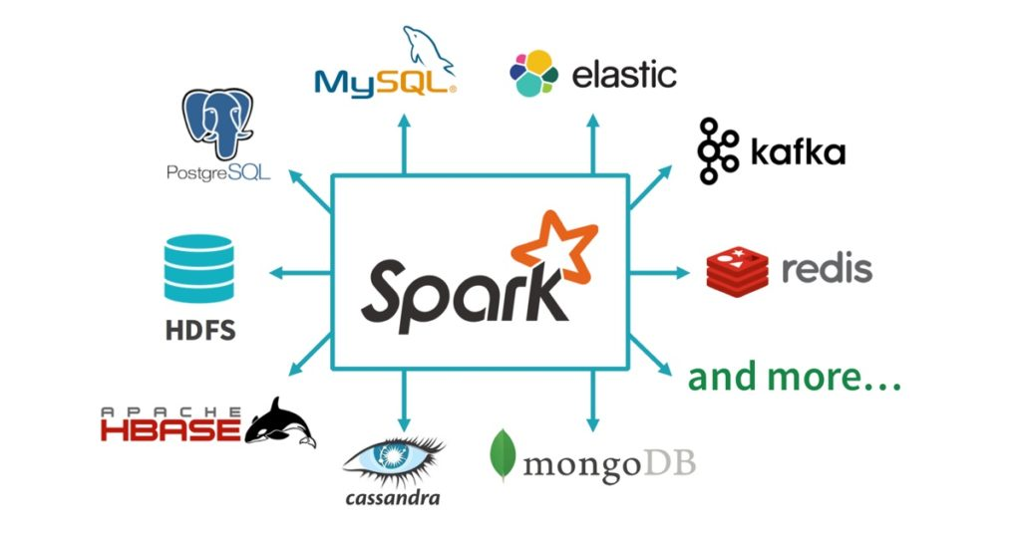
What’s Spark?
Apache Spark is a unified analytics engine for large-scale data processing.
It lets you write applications in Java, Scala, Python, R, and SQL and runs on Hadoop, stand-alone, or in the cloud (and many other platforms).
Spark can be 100 times faster than Hadoop.

Slide 24
Resilient Distributed Datasets (RDDs)
Apache Spark uses fault-tolerant resilient distributed datasets (RDDs), which can be operated on in parallel.

Slide 25
Spark DataFrames
Apache Spark also provides a DataFrame API similar to Pandas.
A DataFrame is a distributed collection of data that is organized into columns and rows.
Unlike Pandas, Spark DataFrames can scale to handle petabytes of data on clusters of servers or in the cloud.

Slide 26
Questions and Discussion

